Slide 1
Thursday, April 12, 2018
Presentation for the Australian Association for Infant Mental Health’s West Australian Branch
Kate Wasserman, MSW, LCSW-C
kate.wasserman@ssw.umaryland.edu

Slide 2


Objectives
Gain conceptual and working knowledge of ECSII domains and scoring
Understand ECSII within a Wraparound and System of Care (SOC) context
Understand service intensity and how to use ECSII in team planning process
Understand the utility of the ECSII to evaluate practice and track progress

Slide 3

But First!
To Rochelle and Jenna!

Slide 4


Participant Perspectives
Your name, setting and role.
What do you hope to learn about the ECSII?

Slide 6

Starting with the premise that kids, and parenting, and families are stressful!
First, Understanding Infant & Early Childhood Mental Health

Slide 7

When you think of Early Childhood Mental Health… what comes to mind?

Slide 8

Introducing the ECSII
What is the ECSII?
  An instrument to assist providers in determining service intensity for infants, toddlers, and children ages 0-5 with or at risk for emotional, behavioral and/or developmental disorders
  Developed by the American Academy of Child and Adolescent Psychiatrists, 2003-2009
  Evolved from the Child and Adolescent Service Intensity Instrument (CASII), 2000
  Based on System of Care (SOC) and wraparound values/context

Slide 9

ECSII Helps to Conceptualize and Materialize Our Definition of Infant and Early Childhood Mental Health
Infant and Early Childhood mental health is the developing capacity of the child from birth to 5 years old to:
Experience, regulate, and express emotions without lasting emotional collapse
Form close and secure interpersonal relationships;
Explore the environment and learn; all in the context of family, community, and cultural expectations for young children.
Source: Zero to Three - National Center for Infant, Toddlers, and Families

Slide 10

Core Competencies Approach to Addressing IMH needs
Family and youth-guided multidisciplinary teams with care coordination capability
Individualized and integrated care plans
Use of evidence-based guidelines
Established and accountable relationships with other entities
Data-informed planning
American Academy of Pediatrics, Task Force on Mental Health. Strategies for System Change in Children's Mental Health: A Chapter Action Kit. Elk Grove Village, IL: American Academy of Pediatrics; 2007. Available at: www.aap.org/mentalhealth/mh2ch.html. Accessed April 21, 2009

Slide 11
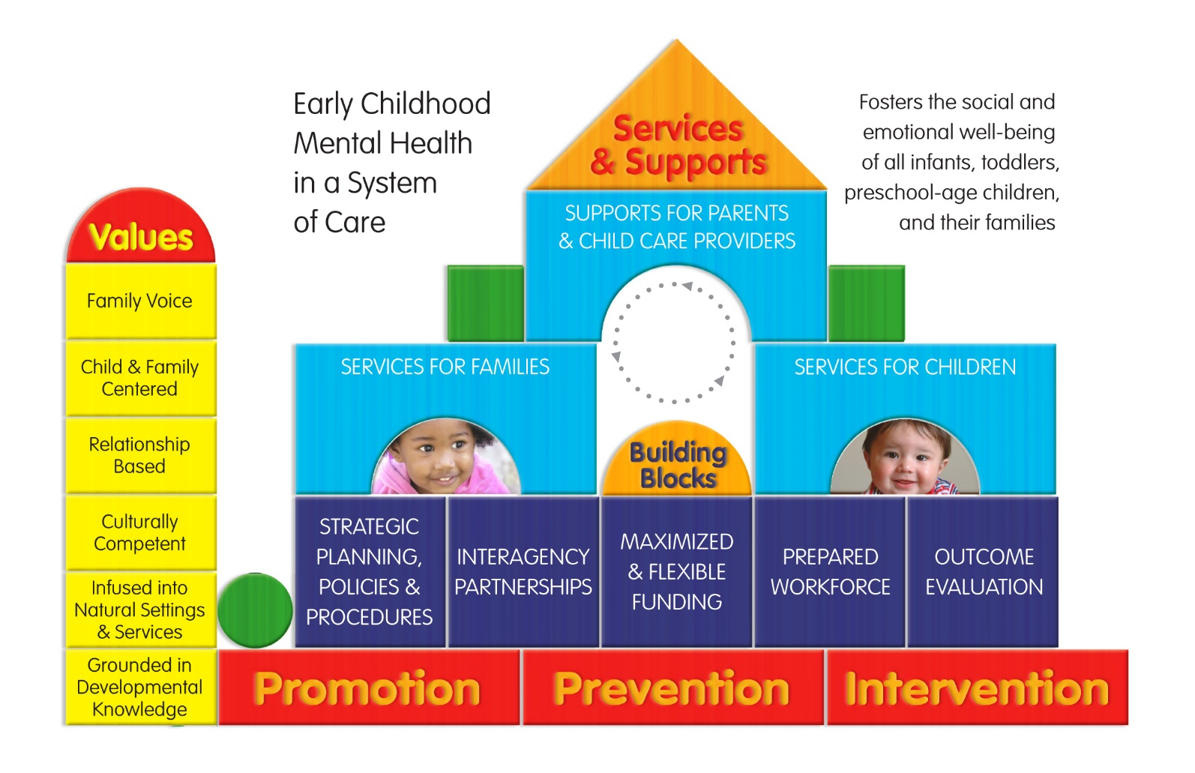
Early Childhood System of Care
Developed by Roxane Kaufmann, GUCCHD; design by: Lucia Foley, Hampshire Educational Collaborative

Slide 12
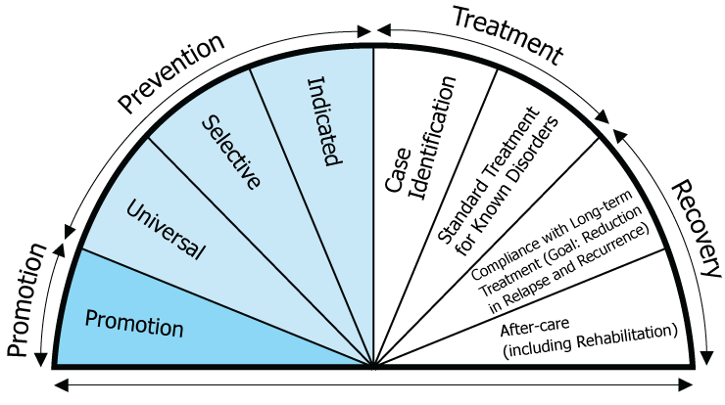
SAMHSA’s Behavioral Health Continuum of Care Model
Based on the Mental Health Intervention Spectrum, first introduced in a 1994 Institute of Medicine report, the model includes the following components:
  Promotion — Strategies designed to create environments and conditions that support behavioral health and the ability of individuals to withstand challenges.
  Prevention — Delivered prior to the onset of a disorder, these interventions are intended to prevent or reduce the risk of developing a behavioral health problem.
  Treatment — Services for people diagnosed with a mental health condition or disorder.
  Recovery — Services to support individuals’ abilities to live productive lives in the community following treatment.

Slide 13

ECSII Overview
Overview: Developed by the American Academic of Child and Adolescent Psychiatrists (AACAP), the ECSII determines intensity of service need for infants, toddlers, and children from ages 0-5 years.
The ECSII is a tool for providers and others involved in the care of young children with emotional, behavioral, and/or developmental needs, and their families, including those children who are experiencing environmental stressors that may put them at risk for such problems.
Domains of the ECSII:
  I: Degree of Safety
  II. Caregiver-Child Relationships
  III. Caregiving Environment
  IV. Functional/Developmental Status
  V. Impact of Medical, Developmental, or Emotional/Behavioral Problems
  VI. Services Profile

Slide 14

Elements of Service Intensity
Focus and setting of interventions
Extent of specialized services
Number, frequency, duration of interventions
Support for safety and daily functioning
Number of systems/agencies involved, and degree of care coordination required
Extent of community and natural supports

Slide 15




Who uses it?
The ECSII can be used by any agency or provider trained and working with these youth and families. This can include:
Primary health care
Mental health care
Early education
Child welfare/Social Services
Early intervention/developmental disabilities
Substance use treatment providers
Court/legal system

Slide 16

When is it used?
  At intake
  When change in service is being considered
  When a team is stuck
  With treatment plan/authorization updates
  At end of services

Slide 17
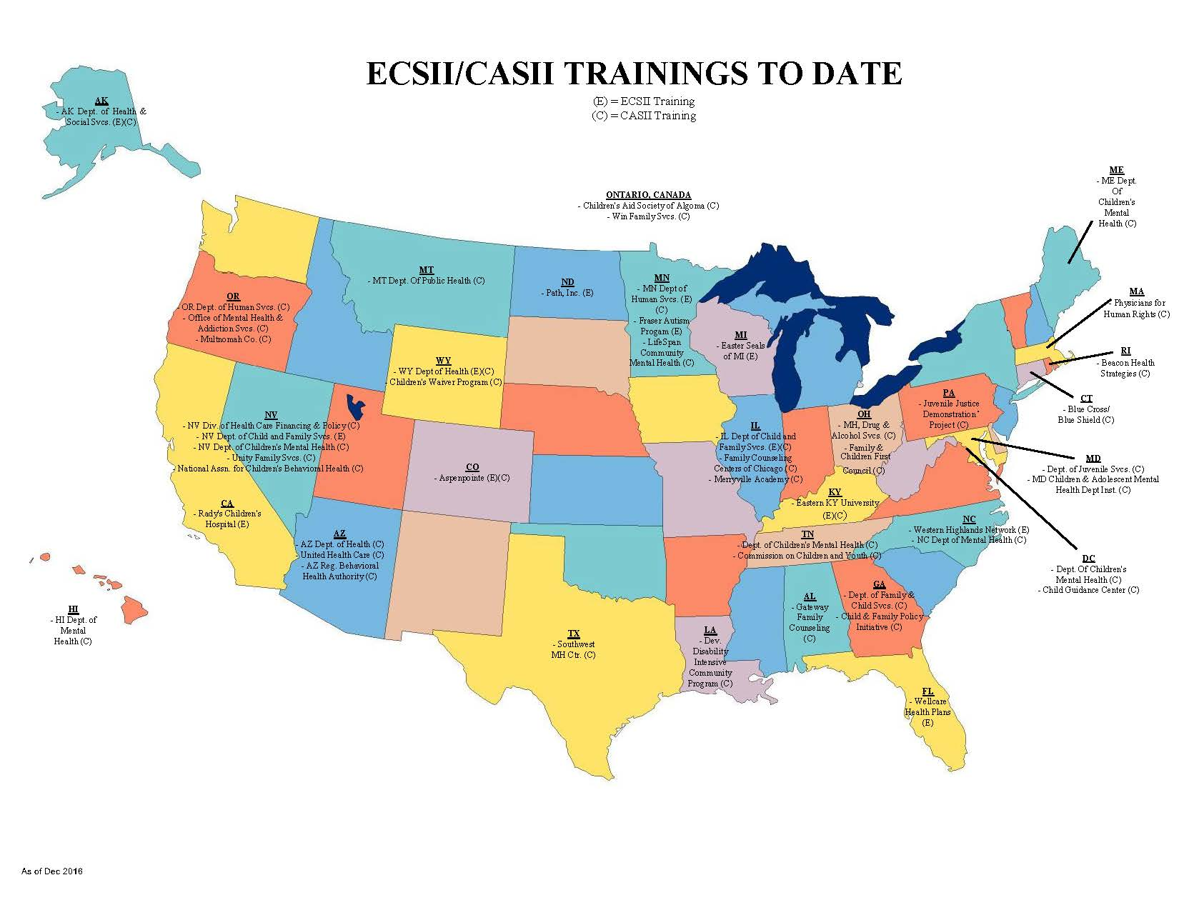
Where is it used? ECSII and/or CASII: 32 states, ECSII: 12 states
Notes:
Up to Dec 2016

Slide 18

State Example: Minnesota
Since July 1, 2009, DHS in Minnesota has required providers to utilize the CASII or ECSII and SDQ for children receiving publicly funded mental health services.
  Utilization:
    All clinical services
    Case management purposes
    For level of care screenings for residential placements.
The ECSII and SDQ should be completed on young children (under 6 years of age) receiving MH TX through Medicaid at intake, at least every three months and at discharge.
State care coordination illustrated cost savings to the state by implementation of system for proactive, community-based interventions rather than expensive crisis-response care, often involving removal from home and community.

Slide 19

Domain 1: Degree of Safety
Child’s potential to be harmed by others or cause significant harm to others – Neglect, Abuse, risk for Accidents
  Environmental dangers
    How safe is environment: entry/exit, poison, dangerous objects
  Supervision
    Are they supervised, watched
  Behavioral factors
    Impulsive/reactive creates eloping, dangerous reactions (e.g. throwing things)
    Capacity of caregivers to keep child safe
  Developmental trauma lens
    Does child know when to perceive things as unsafe
Pg. 12-15

Slide 20

Domain 2: Caregiver Relationships
Enjoyment for both child and caregiver
Degree of reciprocity and warmth in interactions
Flexibility of relationship and ability to withstand stressors
Degree to which caregiver is attuned to child’s developmental level and emotional needs and has a positive view of the child
Overall impact of child-caregiver relationship on the functioning of both child and caregiver
*The rater should determine most important caregivers and rate each separately, no more than three
Pg. 16-18

Slide 21
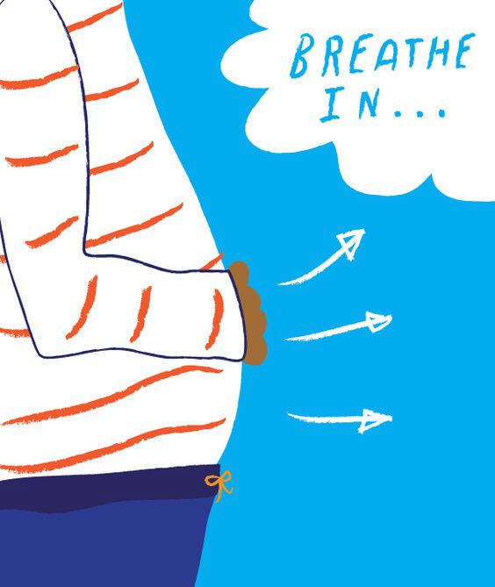

Caregiving Environment and Regulation
Risk associated with the caregiving environment centers around parenting that is negative and inconsistent and family social adversity (Campbell, 1995)
  Conflict, confusion, overwhelming environment
  Parental Depression
  Abuse/Neglect
  Coercive Parent-Child interactions
Notes:
21

Slide 22

Regulatory challenges & the caregiving environment
PARENTS OR CAREGIVERS
  Do they notice uniqueness?
  Do they notice and attribute to uniqueness in child, or to purposeful behavior?
  What is parents’ reaction to child’s behavior?
  How does this fit with their expectations?
  Does child “reward” parents or frustrate them?
  Effects of feeding, crying, sleeping difficulties on parents?
  Child’s need for supervision, attention etc?

Slide 23

Domain 3: Caregiving Environment
Rates factors in the child's current caregiving environment that may contribute directly to optimizing or impairing the child's development and functioning (quality of child’s relationship with significant caregivers is rated in Domain 2 rather than this domain).
Two subscales
  Strengths/protective factors
  Stressors/vulnerabilities
Pg. 19-23

Slide 24
Domain 3: Caregiving Environment
  Strengths/protective factors
    Strong support system
    Safe and reliable housing
    Steady employment/income
    School for child
    Community engagement
    Access to services
  Stressors/vulnerabilities
    Caregiver mental health
    Criminal behavior/incarceration
    Domestic violence
    Poverty
    Caregiver trauma
    Community violence
Pg. 19-23

Slide 25

Domain 4: Functional Developmental Status
Child’s functioning and developmental status completed to same aged peers
  Affective state and state regulation
  Adaptation to change
  Biological patters (eating, sleeping, toileting)
  Social Interactions with adults and other children
  Cognitive, language (receptive & expressive), and motor (fine & gross)
Pg. 24-27

Slide 26
Domain 4: Functional Developmental Status
Affective state and state regulation
  Calm, alert state: Independently, with environmental modification, easily disrupted, difficult to achieve
  Appropriate range of affect: Easy to observe, accurately reflects activities/environment, restricted, inappropriate
  Can regulate emotions: Reacts when upset but easy to calm or redirect, tantrums (how often, how long, how intense), withdraws, difficult to manage/calm
Adaptation to change
  Response to transitions/change: Can adapt, upset with successful with support, cannot tolerate it, very difficult to move on
  Flexible when things go wrong: Easily redirected, can shift gears, difficulty moving past what they wanted
  Response to new environment or stimuli: Enjoys exploration, curious, nervous but with support successful, lack of tolerance, easily upset/scared, very avoidant

Slide 27

Domain 4: Functional Developmental Status
Biological patterns (eating, sleeping, toileting)
  Routines around sleeping, eating toileting in place
  Regression in one or more areas
  Mild or significant support needed for success: Extensive sleep routine, frequent awakenings, prolonged toilet training, limited eating or battles over food
Social Interactions with adults and other children
  Appropriate relationships with others, enjoys/seeks attention, avoidant/dismissive, aggressive
  Prefers attachment figures over others, indiscriminate toward adults
  Highly impulsive with others, no personal “bubble”, goes with anyone, needs monitoring
  Risk for school suspension, expulsion

Slide 28

Domain 4: Functional Developmental Status
Cognitive, language (receptive & expressive), and motor (fine & gross)
  No concerns from parents or providers, has passed screens
  Mild concerns, being monitored, may have early intervention services
  Significantly impaired, interferes with functioning and/or relationships
  Prompts ECSII Completers to consider –
  Does developmental delay contribute to behavioral
  presentation?

Slide 29

Domain 5: Impact of Medical, Developmental or Behavioral Problems
Impact of medical, developmental, or behavioral problems on
  Child’s capacity
  Parent functioning
  Dyadic interaction
  Family life
  How much does problem impact the family vs how severe the problem is?
Pg. 27-29

Slide 30

Domain 5: Impact of Medical, Developmental or Behavioral Problems
Are problems chronic, episodic
Is functioning in school, community, with peers impacted
Are caregivers burdened by time, financial needs of child, job impacted, childcare impacted
Are siblings, adult relationships strained

Slide 31
Service Intensity Levels
Pg. 29-37
Each domain lists 5 levels of intensity:
ECSII Service Intensity Levels
Level | 0 | Basic Health Services
Level | 1 | Minimal Service Intensity (beginning care)
Level | 2 | Low Service Intensity
Level | 3 | Moderate Service Intensity
Level | 4 | High Service Intensity
Level | 5 | Maximal Service Intensity

Slide 32

Scoring!
Mental health providers rate children on 5 domains: Degree of Safety, Child-Caregiver Relationships, Caregiving Environment , Functional/Developmental Status, and Impact of Medical, Developmental, or Emotional/Behavioral Problems.
Each domain has five levels that form scales from1 (low or minimum problem area) to 5 (extreme problem area). Higher numbers indicate higher levels of problems or lower levels of strengths.
A sixth domain— The Services Profile Domain is intended to provide insight as to whether current services match up to the child and family needs and inform providers how they can better shape services to improve outcomes.
The Services Profile includes three subscales: Involvement in Services (rated for Caregiver(s) and the Child); Services Fit; and Service Effectiveness.
The ECSII yields a single level of service intensity score from Level 0 (basic health care) to Level V (full support) which guides providers and caregivers in selecting appropriate services at the appropriate intensity
Pg. 38

Slide 33

Components of Scoring!
Suggested to complete the tool with the family, embedded within a comprehensive clinical assessment.
Flexible tool, intended to be used throughout the course of a case regularly for benchmarks.
  And to be repeated as indicated if new crisis or context emerges.
Clinical experience utilized – score is often driven from clinical perspective and gut.
Anchor point may include multiple descriptors, not all descriptors must be met to choose that level.
If you don’t have the information needed to rate the domain, don’t make assumptions, go back to the record or the family to obtain the information.

Slide 34

Scoring!
Tips for rating the ECSII:
Rating can be done with family team
Read description of domain and anchor points (not all anchor points need to be met)
Start in middle of the level of service score and go up or down
“Zoom in and zoom out” when considering case elements
Avoid speculation
Identify which home and caregiver (s) you are scoring – there are times when it is appropriate to conclude TWO different ECSII scores, if child has different environments or caregivers within different times (e.g. visitation, split custody)
Select a point in time (30 day window)
Elements for calculating service intensity:
Focus and setting of interventions
Extent of specialized services
Number, frequency, duration of interventions
Support for safety and daily functioning
Number of systems/agencies involved, and degree of care coordination required
Extent of community and natural supports

Slide 35
Even More Tips for Scoring the ECSII
Rating can be done with family team
Read description of domain and anchor points (not all anchor points need to be met)
Start in middle and go up or down
“Zoom in, zoom out”
Avoid speculation
Identify which home and caregiver (s) you are scoring
Select a point in time (30 day window)

Slide 37

Understanding the Service Profile
Only scored if there have been previous services or “intervention”
Informs possible changes to current services
Leads to thoughtful consideration of quality and fit, not just quantity
Does not usually change the overall score, but informs service planning
Can also serve as outcome measure

Slide 38

Case Review
Jointly discuss and score “Billy’s” case

Slide 40
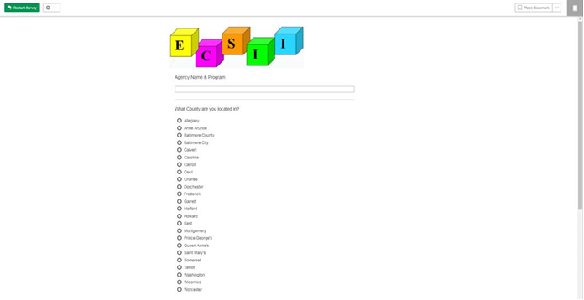
Qualtrics Data Entry for ECSII Data
ECSII MARYLAND
https://umaryland.az1.qualtrics.com/jfe/form/SV_7O4AfuhF1r7dLet

Slide 41
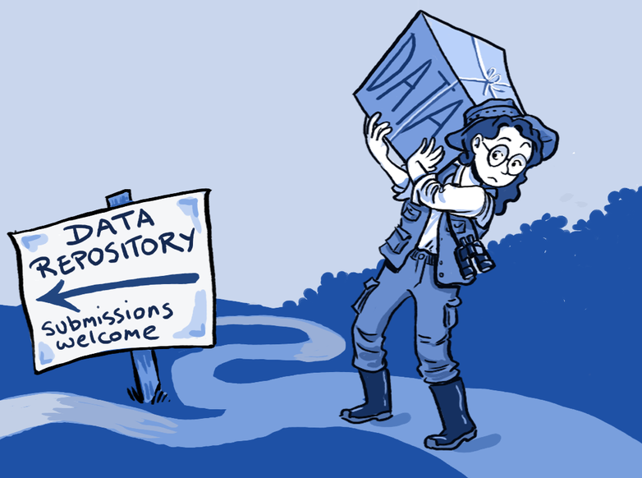
Scoring & Reporting ECSII
We ask that participants start using ECSII at intake of new clients or existing cases during this period.
UMB SSW Evaluation team can work with specific teams about other opportunities within treatment/intervention cycle for established clients/patients.
ECSII score sheets can be either:
  scanned and sent into U Maryland SSW team or
  Entered into Qualtrics link

Slide 42

System of Care Grant ECSII Evaluation Plan
All elements of scoring will be entered into a database to look at trends in data and patterns in ECSII usage.
Service Intensity of interventions, specialized services, community supports, safety/daily functioning supports, and agency involved will be collected (e.g. frequency, duration). This will be extracted from ECSII comments column, which will need to be completed on the forms.
Information about challenges and benefits of ECSII implementation will be collected from the monthly calls to determine implementation factors that lead to success.
Informal qualitative interviews will be conducted at the end of the coaching period to get feedback on pros/cos of ECSII implementation and outcomes for families.

Slide 43

Implementation Support
We know that sitting through the training is only the beginning when trying to learn and implement a new tool or practice.
Standing TA Calls: University of Maryland SSW team will host a standing call to talk through cases, questions that came up in scoring, etc. on the FIRST Friday of each month from 9:30 – 10:30.
{Participants can call into every call, or as needed, but content will support
scoring implementation, hear case reviews and examples from peers, etc.}
Analysis: Brief Qualitative Interviews completed with participants, analysis of data submitted and discussion with BRIDGE leadership committee about next steps, more trainings + dissemination across the state!

Slide 44

Questions? Ideas?

